Slide 1
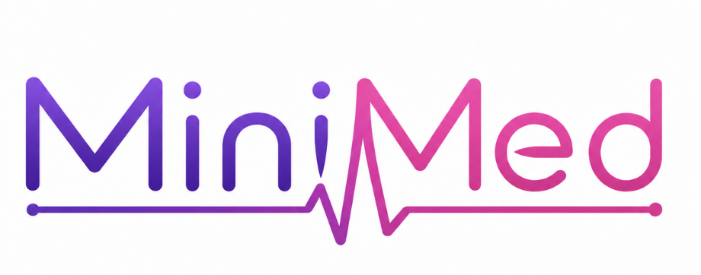
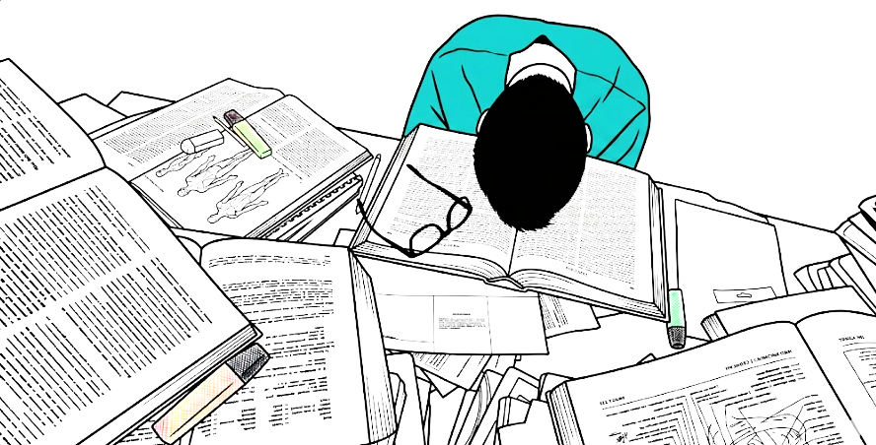

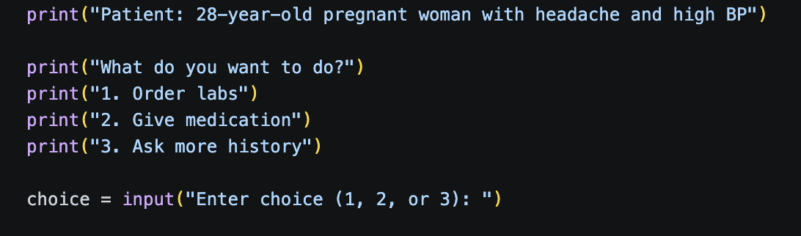
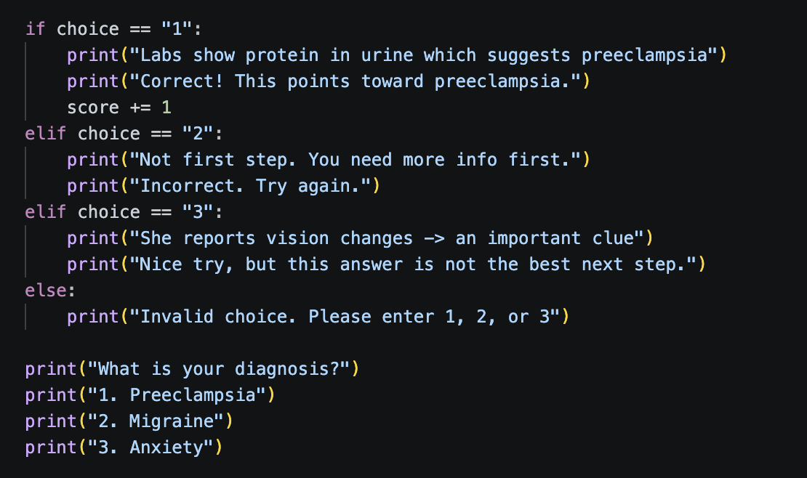


By: Ryan Azadi
Having Trouble Memorizing?
An interactive python program that helps medical students practice and make clinical decisions!!
MiniMed will put your through a clinical scenario by presenting a question with different possible options (most of medical school is gaining clinical experience)
What It Does
Why It Matters
This program simply:
Presents patient cases
Allows users to make clinical decisions
Gives feedback on choices
Tracks score
Includes diagnosis step
My sister is a medical student and she told me that at a certain point its not just studying terms, its going through and experience clinical scenarios, so this program:
Helps students move beyond
memorization skills
Activates real clinical-like
thinking
Builds decision making
It then builds on your choice and gives other possible options from the step you are on to get you to a conclusion

